Slide 2
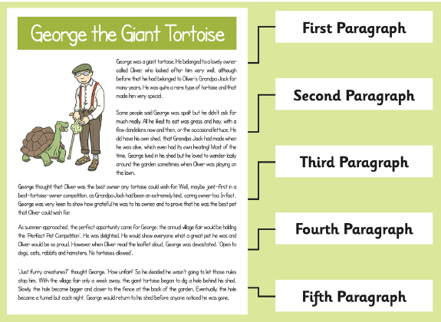
What is a Paragraph?
A paragraph is a group of sentences within a piece of writing which is written about the same idea or topic.
Paragraphs are often separated by missing a line between them.

Slide 3
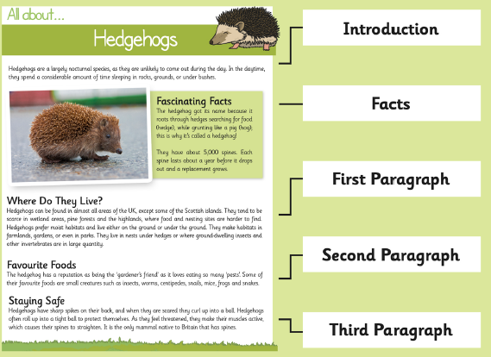
What is a Paragraph?
Paragraphs are used to show when a writer has changed time, place or argument. When they do this, they will start a new paragraph.
In a non-fiction text, we usually see a subheading before each paragraph, telling us what it will be about.

Slide 4
Why Do We Use Paragraphs?
Why do you think we use paragraphs in a piece of writing? Mind map your ideas as a group.
To show the author has changed time, place or argument.
To explain or describe an idea in detail.
Paragraphs
To organise what is being explained in a text.
To group ideas together.
To make the text easier to read.

Slide 5
Sorting Ideas in Topics
Can you read the sentences below and group them into sentences which talk about the same idea or topic?
Castles are a type of home that were built to protect the people inside.
People who lived in castles included royalty, noble people and soldiers.
You can still visit many castles today. Why not take a tour?
Everything about a castle was made that way to keep the people inside safe.
Famous castles include Windsor Castle, Dover Castle and Kenilworth Castle.
Castles could be very crowded places to live because there were a lot of people inside.

Slide 6
Sorting Ideas in Topics
Can you read the sentences below and group them into sentences which talk about the same idea or topic?
Castles are a type of home that were built to protect the people inside.
These two sentences are about castles as protection.
Everything about a castle was made that way to keep the people inside safe.
Castles could be very crowded places to live because there were a lot of people inside.
These two sentences are about the people who lived in castles.
People who lived in castles included royalty, noble people and soldiers.
Famous castles you can visit include Windsor Castle, Dover Castle and Kenilworth Castle.
These two sentences are about castles you can visit.
You can still visit many castles today. Why not take a tour?

Slide 7
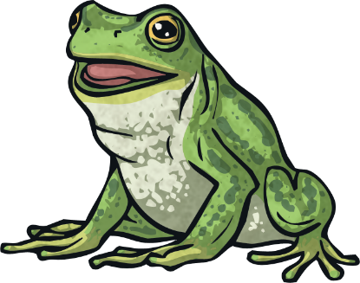
Using Paragraphs
The following text does not have paragraphs to sort the ideas. Can you identify where the topic changes?
Frogs are amphibians, which mean that they can live both on land and in the water. They are cold-blooded which means that their bodies are the same temperature as the air. When they get cold, they need to lie in the sun to warm up and when they get too warm, they need to go into the water or find a shady place to cool down. Frogs are found all over the world. They are found in every climate and on all continents except Antarctica. They are often found near any source of fresh water but they prefer water which does not move very quickly. Smaller frogs eat flies and insects, especially crickets. Larger frogs can eat mice! Frogs do not need to drink because they absorb water through their skin.
How many paragraphs could we split this piece of text into?

Slide 8
Using Paragraphs
Were you able to identify where the topic changes? Let’s organise this text into paragraphs.
Frogs are amphibians, which mean that they can live both on land and in the water. They are cold-blooded which means that their bodies are the same temperature as the air. When they get cold, they need to lie in the sun to warm up and when they get too warm, they need to go into the water or find a shady place to cool down. // Frogs are found all over the world. They are found in every climate and on all continents except Antarctica. They are often found near any source of fresh water but they prefer water which does not move very quickly. // Smaller frogs eat flies and insects, especially crickets. Larger frogs can eat mice! Frogs do not need to drink because they absorb water through their skin.

Slide 9
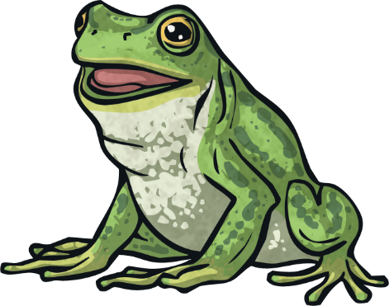
Frogs are amphibians, which mean that they can live both on land and in the water. They are cold-blooded which means that their bodies are the same temperature as the air. When they get cold, they need to lie in the sun to warm up and when they get too warm, they need to go into the water or find a shady place to cool down.
Frogs are found all over the world. They are found in every climate and on all continents except Antarctica. They are often found near any source of fresh water but they prefer water which does not move very quickly.
Smaller frogs eat flies and insects, especially crickets. Larger frogs can eat mice! Frogs do not need to drink because they absorb water through their skin.

Slide 10
Subheadings in Non-Fiction Texts
As this is a non-fiction text, can you think of a good subheading to tell the reader what each paragraph is about?
_______________________
Frogs are amphibians, which mean that they can live both on land and in the water. They are cold-blooded which means that their bodies are the same temperature as the air. When they get cold, they need to lie in the sun to warm up and when they get too warm, they need to go into the water or find a shady place to cool down.
_______________________
Frogs are found all over the world. They are found in every climate and on all continents except Antarctica. They are often found near any source of fresh water but they prefer water which does not move very quickly.
_______________________
Smaller frogs eat flies and insects, especially crickets. Larger frogs can eat mice! Frogs do not need to drink because they absorb water through their skin.

Slide 11
What are frogs?
Frogs are amphibians, which mean that they can live both on land and in the water. They are cold-blooded which means that their bodies are the same temperature as the air. When they get cold, they need to lie in the sun to warm up and when they get too warm, they need to go into the water or find a shady place to cool down.
Where are frogs found?
Frogs are found all over the world. They are found in every climate and on all continents except Antarctica. They are often found near any source of fresh water but they prefer water which does not move very quickly.
What do frogs eat?
Smaller frogs eat flies and insects, especially crickets. Larger frogs can eat mice! Frogs do not need to drink because they absorb water through their skin.

Slide 12
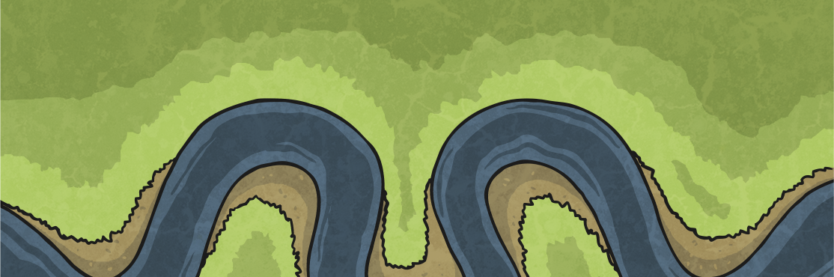
It’s Your Turn...
Here is a piece of text about different rivers of the world. Can you organise the text into paragraphs?
The Nile is the longest river in the world. It is 4132 miles (6650 km) long – that’s nearly seven times the distance from John o’ Groats at the top of Scotland to Land’s End at the bottom of England! When most people think of The Nile they think of Egypt, but surprisingly, only 20% of the river is in Egypt, it also flows through countries including Uganda and Ethiopia before ending at the Mediterranean Sea. The Rhine flows through Germany and is 766 miles (1233km) long. It also travels through another five countries before reaching the North Sea in the Netherlands. Its source is a small stream coming from a glacier in the Swiss Alps (the mountains in Switzerland). The Danube is the second largest river in Europe. It is 1785 miles (2680 km) long and its source is in the Black Forest Mountains in Germany flowing to The Black Sea. This river flows through, or along the border of many different countries including Austria, Hungary, Croatia, Bulgaria and Romania to name a few. It also flows through the capital cities of Belgrade, Budapest, Vienna and Bratislava.

Slide 13
How Did You Do?
With this piece of text, each different topic was a different river so it is simple to separate the text into paragraphs which only focus on one river each, like this:
The Nile is the longest river in the world. It is 4132 miles (6650 km) long – that’s nearly seven times the distance from John o’ Groats at the top of Scotland to Land’s End at the bottom of England! When most people think of The Nile they think of Egypt, but surprisingly, only 20% of the river is in Egypt, it also flows through countries including Uganda and Ethiopia before ending at the Mediterranean Sea.
The Rhine flows through Germany and is 766 miles (1233km) long. It also travels through another five countries before reaching the North Sea in the Netherlands. Its source is a small stream coming from a glacier in the Swiss Alps (the mountains in Switzerland).
The Danube is the second largest river in Europe. It is 1785 miles (2680 km) long and its source is in the Black Forest Mountains in Germany flowing to The Black Sea. This river flows through, or along the border of many different countries including Austria, Hungary, Croatia, Bulgaria and Romania to name a few. It also flows through the capital cities of Belgrade, Budapest, Vienna and Bratislava.

